Slide 1

Vel Tech Rangarajan Dr. Sagunthala R&D Institute of Science and Technology
School of Computing
Department of Computer Science and Engineering
10211CS224 / FULL STACK APPLICATION DEVELOPMENT (JAVA)
PROJECT REVIEW : MILESTONE PROJECT - 2
Date: 22-04-2026
DESIGN AND DEVELOP A REACTJS BASED WEBAPPLICATION FOR TICKET BOOKING OF AN INTERNAL DEPARTMENT EVENT
SDG: SDG 9 — (Industry, Innovation and Infrastructure)
Presented By:
M.P.Girish– VTU24384 – 23UECS0731
Courses Handling Faculty:
Dr.S.Hemamalini - M.E,Ph.d.
Assistant Professor(Senior Grade)

Slide 2

INTRODUCTION
1
The Ticket Booking Management System is a modern, full-stack web application designed to simplify and digitize the process of discovering, booking, and managing event tickets. Built using React.js on the frontend and Node.js with Express on the backend, with MySQL as the relational database, the system provides a seamless experience for three types of users — Attendees,Organizers and Admin
Users can browse events, book tickets, make payments, and write reviews — all from a single platform. Organizers can create and manage their events in real time. An AI-powered chatbot powered by AWS Bedrock is available on every page to assist users with queries instantly.
This project eliminates the inefficiencies of manual ticketing, reduces human error, and brings the entire event management lifecycle onto one secure, scalable digital platform — making it relevant, practical, and ready for real-world deployment.
2
3
4
5
6
7
8
9

Slide 3
PROBLEM STATEMENT
1
Traditional event ticketing relies heavily on manual processes, physical counters, and paper-based records, leading to long queues, booking errors, and poor user experience. As digital adoption accelerates globally, there is a growing need for smart, automated platforms that connect event organizers and attendees seamlessly. Mismanagement of bookings, lack of real-time seat availability, and absence of centralized data cause significant revenue loss and customer dissatisfaction for organizers. This project addresses these challenges by building a full-stack Ticket Booking Management System using React.js, Node.js, Express, and MySQL. The system supports three roles — User, Organizer, and Admin — enabling end-to-end event creation, ticket booking, payment tracking, and review management. An AI-powered chatbot integrated with AWS Bedrock provides instant assistance to users, enhancing accessibility and support. Aligned with SDG 9 (Industry, Innovation and Infrastructure), this platform promotes digital innovation and inclusive access to cultural, educational, and professional events. The system eliminates manual inefficiencies, ensures data integrity through a relational database, and delivers a modern, scalable solution relevant to today's event-driven economy.
2
3
4
5
6
7
8
9

Slide 4
OBJECTIVE(S)
1
2
Digitize Event Ticketing — Replace manual, paper-based booking processes with a secure, real-time online platform that allows users to browse, book, and manage event tickets effortlessly.
Enable Role-Based Management — Provide dedicated dashboards for Users, Organizers, and Admins to manage bookings, events, payments, and user data efficiently from a single system.
Integrate AI Assistance — Embed an AWS Bedrock-powered chatbot to deliver instant, intelligent support to users for booking queries, event information, and cancellation guidance.
3
4
5
6
7
8
9

Slide 5
PROPOSED SYSTEM
Full-Stack Digital Platform — Built with React.js, Node.js, Express, and MySQL to deliver a complete, end-to-end ticket booking experience accessible from any browser without installation.
Real-Time Seat Management — Available seats update instantly after every booking or cancellation, eliminating overbooking and double-entry errors common in manual systems.
Role-Based Access Control — Separate dashboards for Users, Organizers, and Admins ensure each role sees only relevant features, improving security and usability.
Automated Payment Tracking — Every booking automatically generates a payment record with transaction ID, method, and status — replacing manual receipts and cash handling.
AI Chatbot Assistance — AWS Bedrock-powered chatbot provides 24/7 instant support for booking help, event queries, and cancellations — reducing dependency on human support staff.
Centralized Data with MySQL — All users, events, bookings, payments, and reviews are stored in a structured relational database, enabling fast queries, reports, and admin oversight.
Email Confirmation System — Automated booking confirmation emails are sent via Nodemailer, keeping attendees informed without any manual follow-up from organizers.
Scalable & Secure Architecture — JWT-based authentication, encrypted passwords with bcrypt, and middleware-based authorization make the system secure and ready to scale for large events.
1
2
3
4
5
6
7
8
9

Slide 6
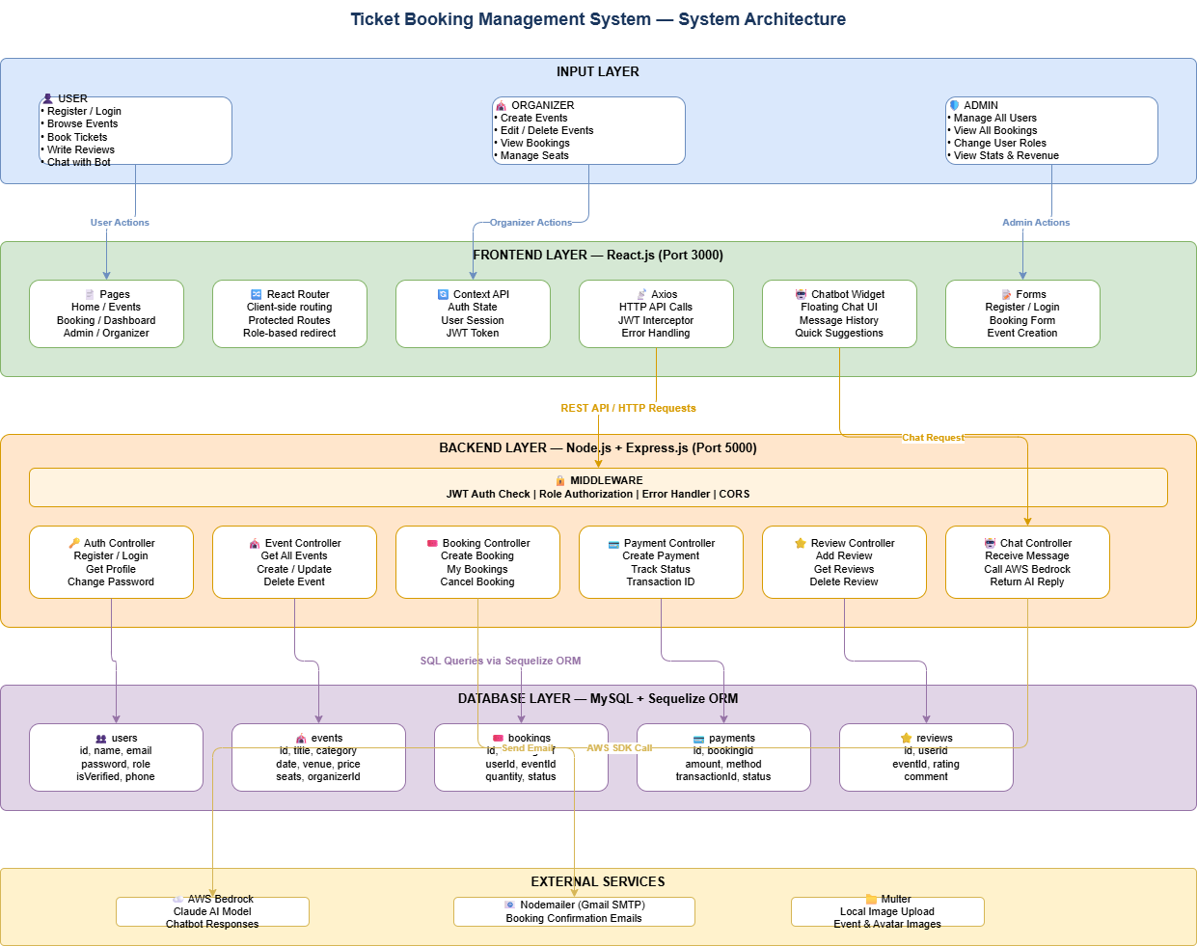
PROPOSED SYSTEM ARCHITECTURE
1
2
3
4
5
6
7
8
9

Slide 7
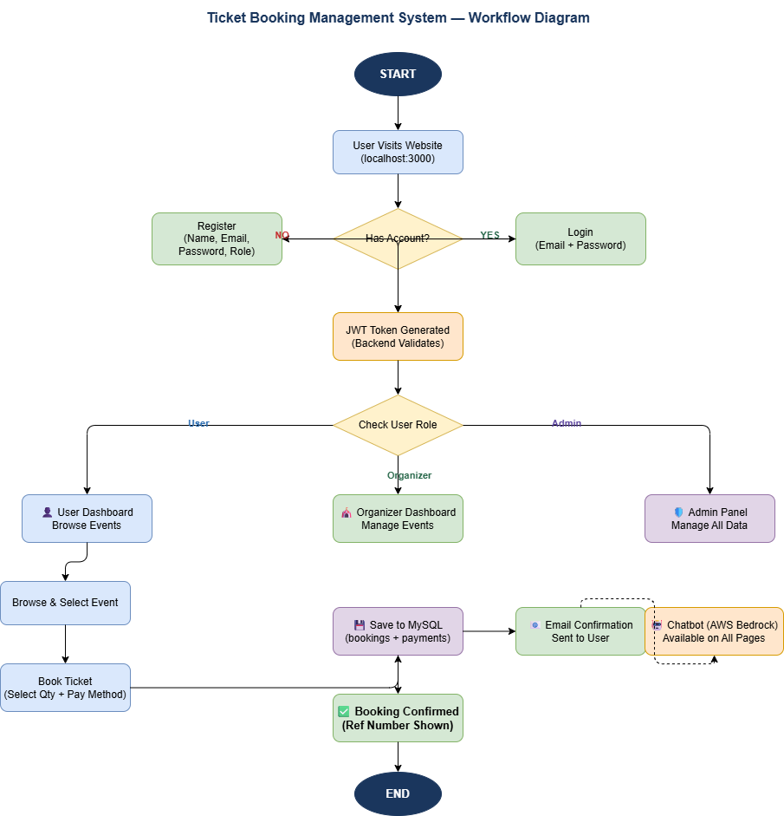
WORKFLOW
1
2
3
4
5
6
7
8
9

Slide 8
TECHNOLOGIES USED
1
2
Frontend: React.js 18, React Router v6, Context API, Axios, CSS-in-JS (Inline Styles).
Backend: Node.js, Express.js, JSON Web Token (JWT), Bcrypt.js, Multer, Nodemailer, Sequelize ORM.
Database: MySQL 8.0, MySQL Workbench (GUI), Sequelize (Object Relational Mapper).
Third-Party API: AWS Bedrock (Claude AI Model) — Chatbot integration via AWS SDK v3.
Tools:Postman (API testing), MySQL Workbench, draw.io (diagrams), Git, npm (package manager).
3
4
5
6
7
8
9

Slide 9
MODULE DESCRIPTION
1
Module 1: User Management Handles secure user registration and login using JWT-based authentication and bcrypt password hashing. Supports three roles — User, Organizer, and Admin — each with dedicated dashboards and role-based access control to restrict unauthorized actions.
Module 2: Core Processing Implements the complete ticket booking workflow including event browsing, seat availability checks, booking creation, payment recording, and cancellation management. All business logic is handled through RESTful APIs built with Node.js and Express, ensuring real-time seat deduction and booking confirmation.
Module 3: Database Management Uses MySQL with Sequelize ORM to manage five relational tables — users, events, bookings, payments, and reviews — with proper foreign key relationships and data validation. Sequelize auto-syncs the schema on server start, ensuring data integrity and consistent query handling.
Module 4: Innovative Module Integrates AWS Bedrock (Claude AI model) as a floating chatbot widget available on every page, providing instant AI-powered responses to user queries about bookings, events, and cancellations.
Module 5: Reporting & Analytics The Admin Panel provides a real-time statistics dashboard displaying total users, total events, confirmed bookings, and cumulative revenue. Organizers can monitor seat availability and booking counts per event, while admins can filter and view all booking and payment records across the platform.
2
3
4
5
6
7
8
9

Slide 10
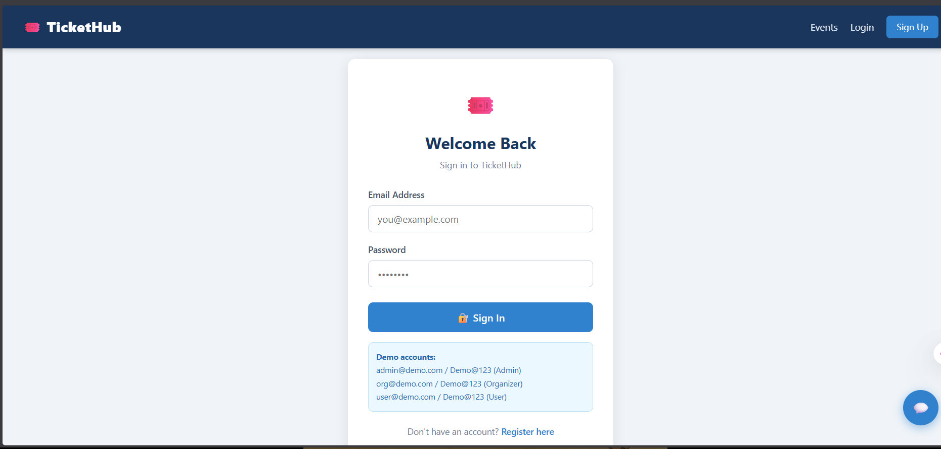
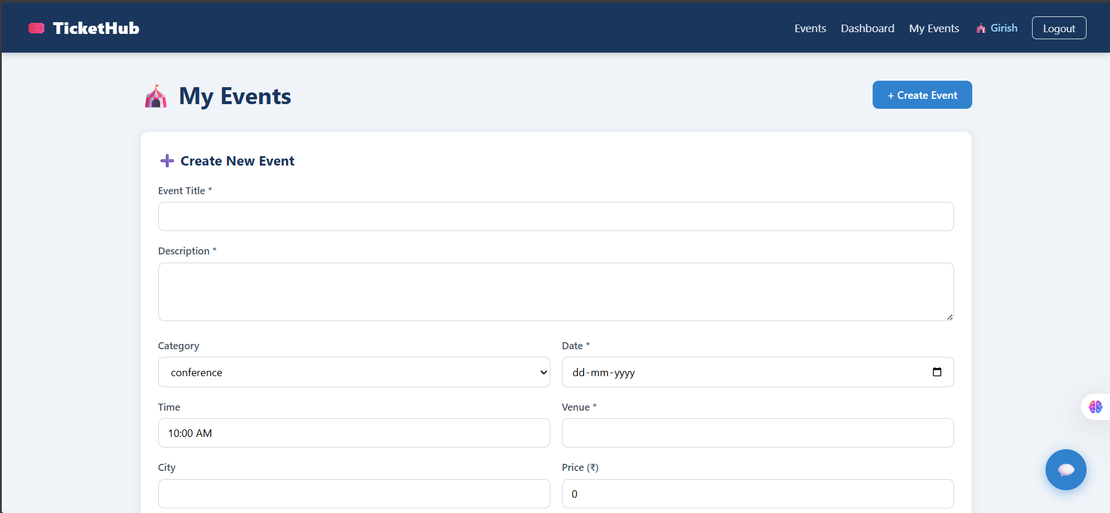
IMPLEMENTATION SCREENSHOTS
1
2
Login Page: A clean and user-friendly login interface that allows users to securely access their TicketHub account.
3
4
5
6
7
8
Event Creation Page: An intuitive form that enables organizers to easily create and manage events by entering key details like title, date, venue, and pricing.
9

Slide 11
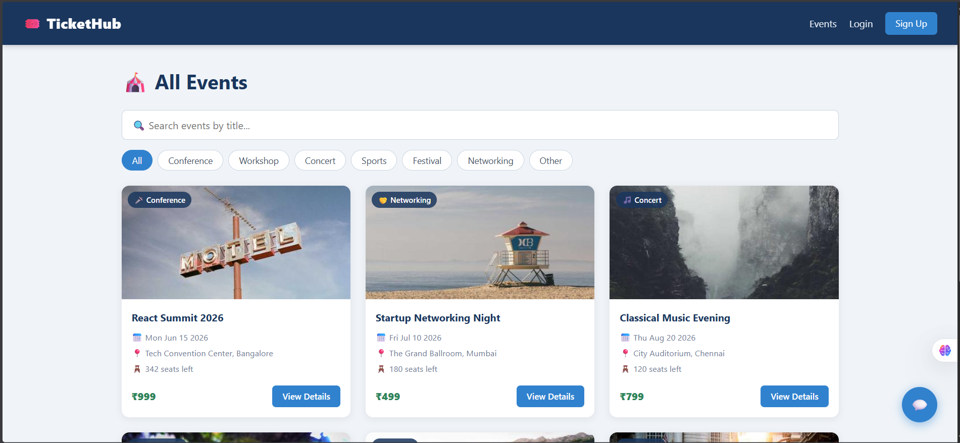
IMPLEMENTATION SCREENSHOTS
1
2
3
4
5
6
7
8(A)
9
HOME PAGE
This is the homepage of TicketHub, showcasing a list of upcoming events with categories, search functionality, and quick filtering options.
Users can explore events, view details like date, location, and pricing, and easily navigate to book tickets.

Slide 12
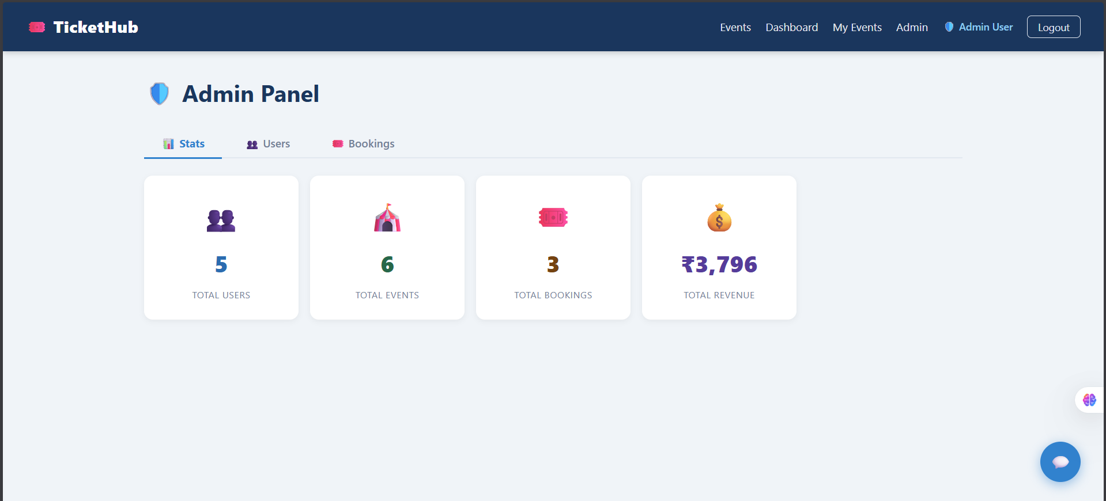
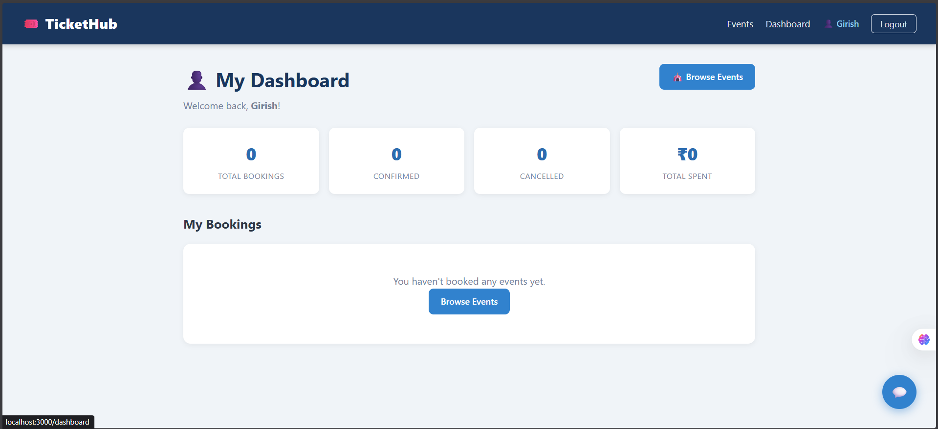
IMPLEMENTATION SCREENSHOTS
1
2
3
4
5
6
ADMIN PANEL
This is the Admin Panel of TicketHub, providing an overview of platform statistics like total users, events, bookings, and revenue.
It allows administrators to manage users, monitor bookings, and track overall system performance efficiently.
USER PANEL
This is the user dashboard of TicketHub, showing a summary of bookings, confirmations, cancellations, and total spending.
It also provides quick access to browse events and manage personal bookings in one place.
7
8(B)
9

Slide 13
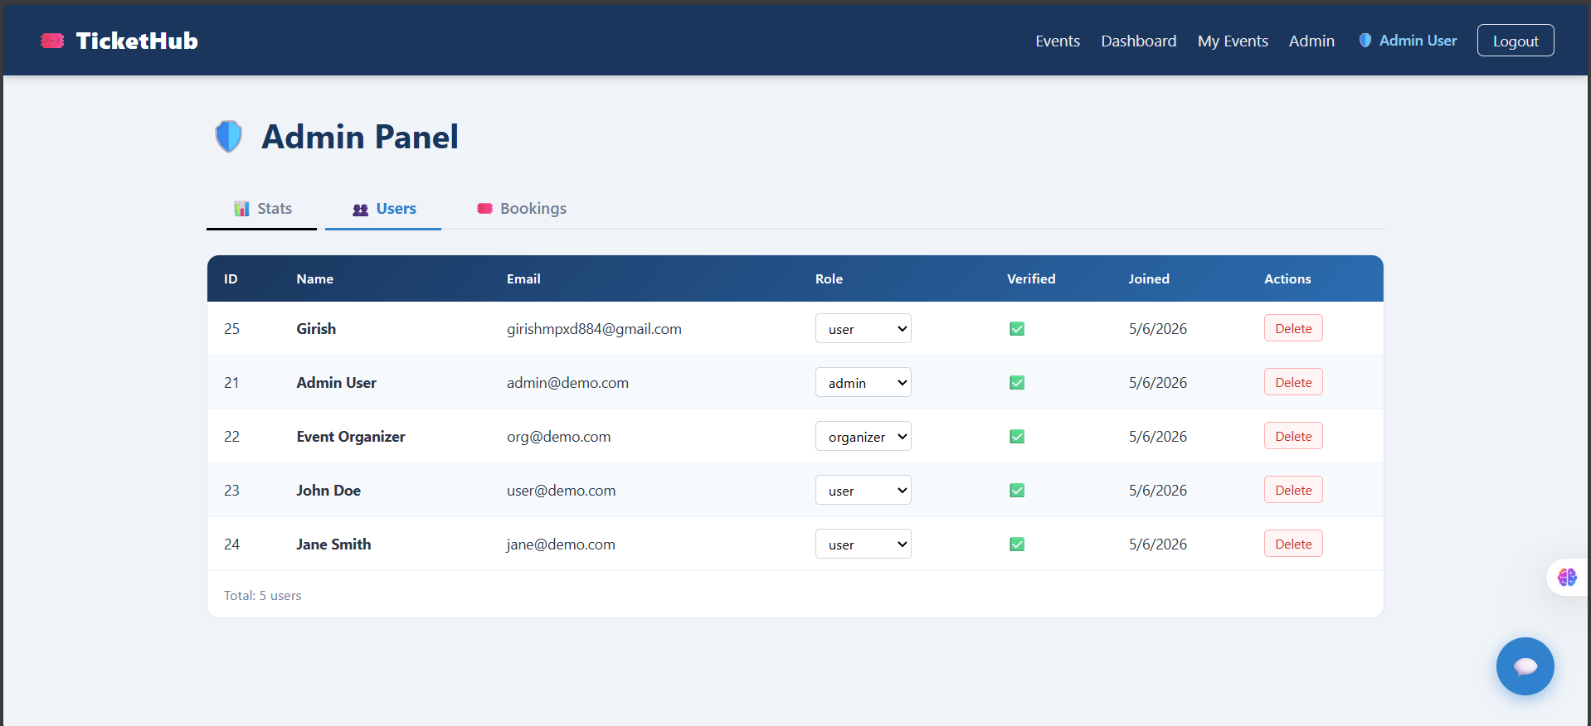
IMPLEMENTATION SCREENSHOTS
1
2
3
4
5
6
7
8(C)
Module 1
The User management page provides a clear overview of all users, including their roles, verification status, and join dates in a structured table.
It also allows admins to easily manage users by updating roles or deleting accounts directly from the interface.
9

Slide 14
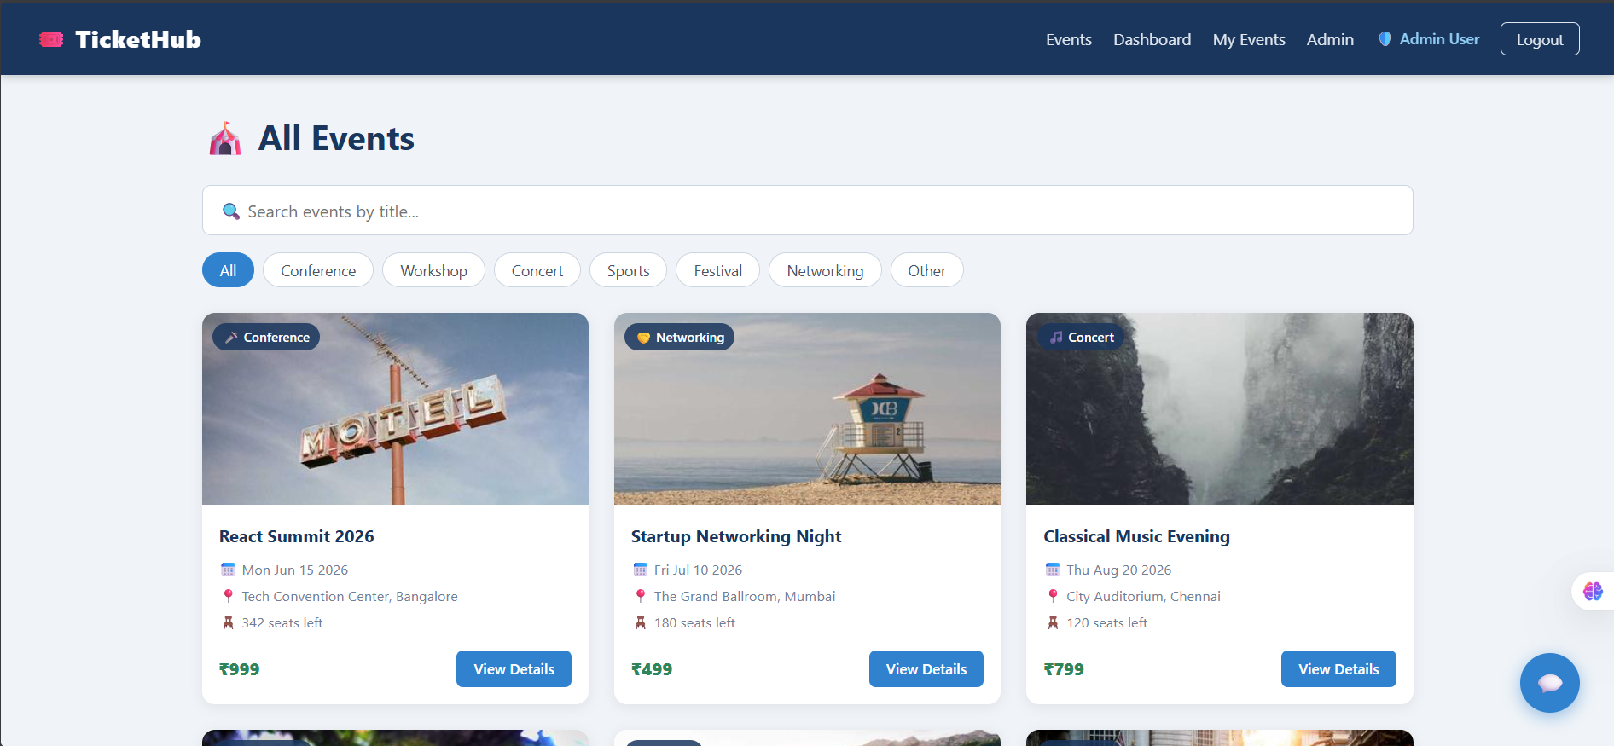
IMPLEMENTATION SCREENSHOTS
1
2
3
4
5
6
7
8(C)
9
Core Processing
The events page showcases a clean, card-based layout with search and category filters, making it easy for users to discover events.
Each event card clearly presents key details like date, location, price, and availability, along with a quick “View Details” action.

Slide 15
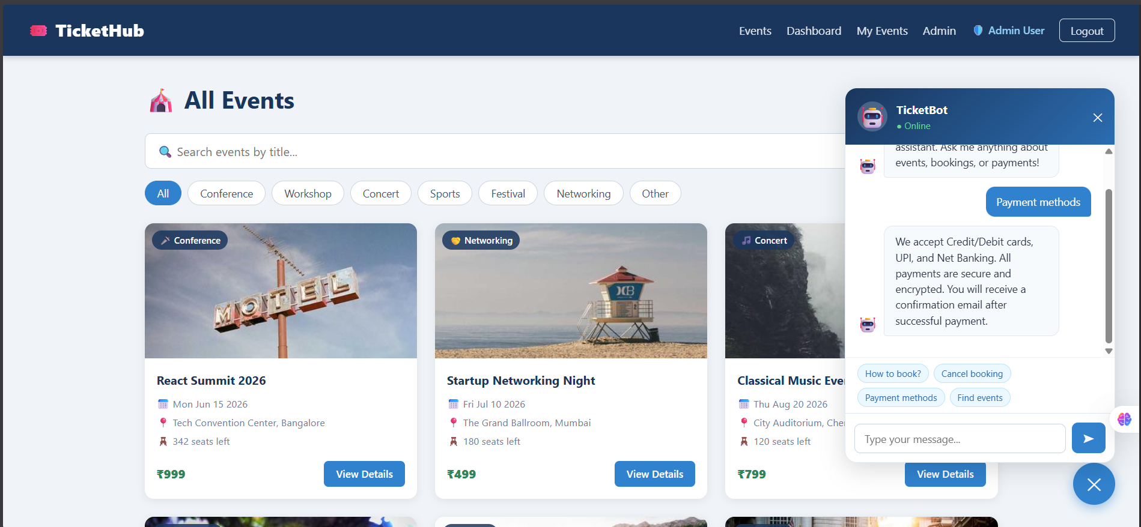
IMPLEMENTATION SCREENSHOTS
1
2
3
4
5
6
7
8(C)
9
Innovative Module
The AI chatbot (TicketBot) adds an interactive support layer, allowing users to quickly get answers about events, bookings, and payments without leaving the page.
It enhances user experience by providing instant assistance and guiding users through actions like booking or resolving queries in real time.

Slide 16
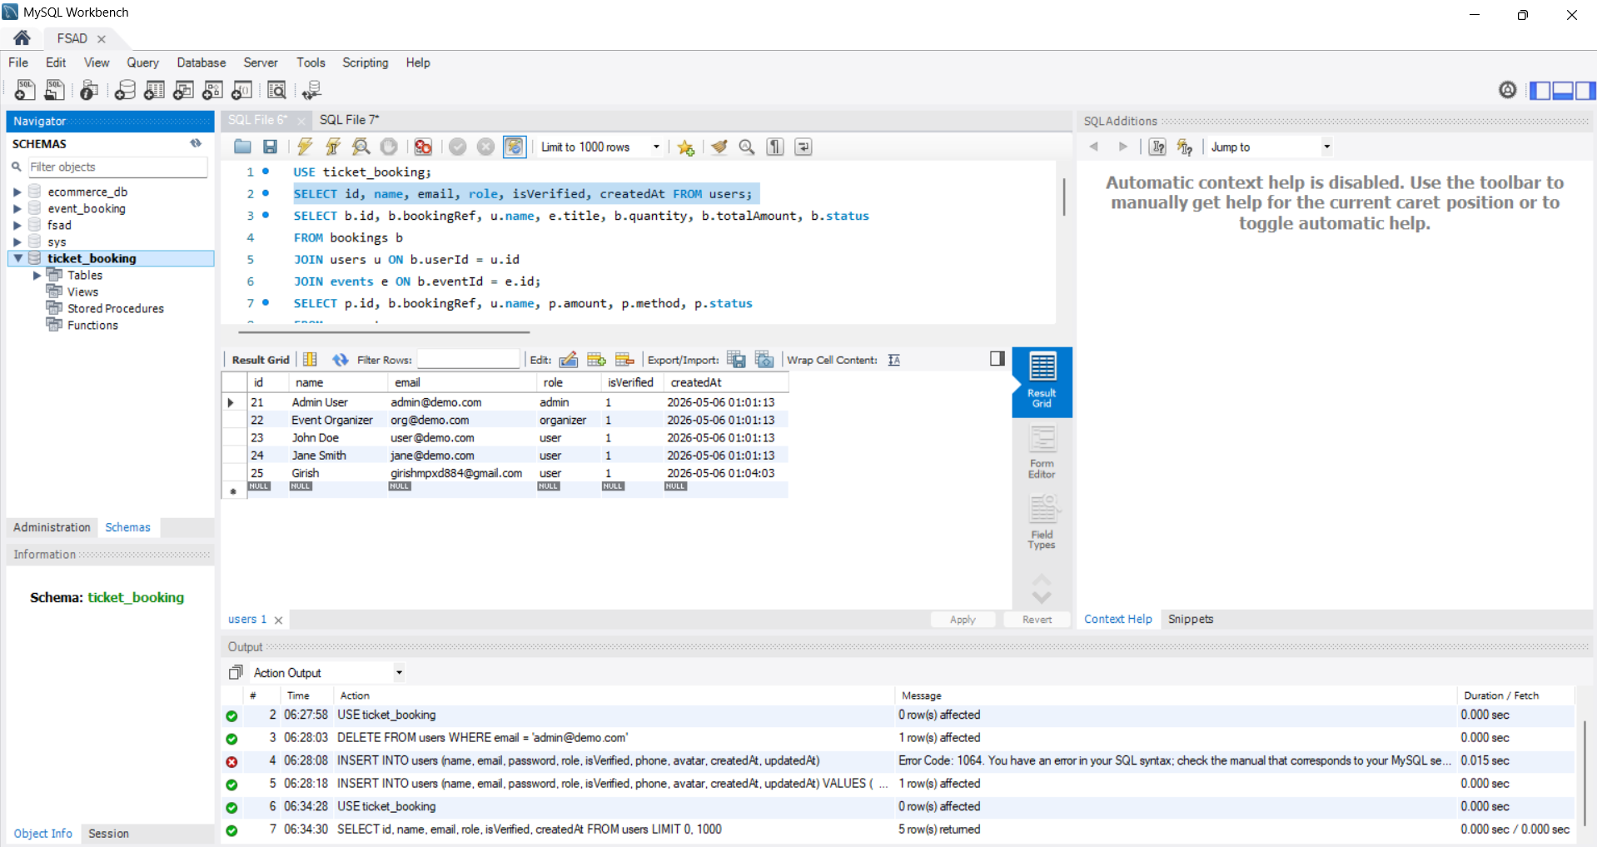
IMPLEMENTATION SCREENSHOTS
1
2
3
4
5
6
7
8(C)
9

Slide 17
ADVANTAGES & LIMITATIONS
1
Advantages
Real-Time Seat Management — Available seats update instantly after every booking or cancellation, eliminating overbooking and ensuring accurate ticket availability at all times.
AI-Powered Chatbot — AWS Bedrock integration provides 24/7 intelligent assistance to users for booking queries, event information, and cancellation guidance without human support.
Secure Authentication — JWT tokens and bcrypt password hashing ensure user credentials are protected and sessions are managed securely across all API requests.
Limitations
No Live Payment Processing — Users cannot make actual payments through the system. The booking is confirmed without real money transaction, which limits its use in a real-world commercial environment.
No Ticket Cancellation Refund Policy — When a user cancels a booking, the system updates the status but does not process any refund automatically, requiring manual intervention outside the platform.
No Event Reminder Notifications — The system does not send any reminder alerts or push notifications to attendees before the event date, which may lead to users missing events they have booked.
2
3
4
5
6
7
8
9

Slide 18
Thank you

